Slide 1
Seat Occupancy Detection and Vital-Signs Monitoring
using TI mmWave Radar Sensor
By,
Pambali Jithendra(4th year, Electrical Engineering, IIT Jodhpur)

Slide 2
Motive
The aim of this project is Vehicle Seat-Occupancy Detection based on the Texas Instrument’s AWR6843ISK evaluation kit at the unlicensed 60 GHz ISM band.
Existing Methods Of Seat Occupancy Detection and their drawbacks
● Pressure sensors, but they detect even when some luggage or some other weight on the seats, they interpret as humans.
● Face detection using cameras, but the cameras won’t be able to recognize in low lights.
● Infrared Cameras, but they won’t be able to detect humans when the cabin is warm enough and they are very expensive.

Slide 3

So, the mmWave RADAR sensor would be a very promising solution to implement a seat occupancy detection system and is also highly advanced to monitor the driver vital signs like heart and inhale rate by which eliminate the drawbacks of existing methods but also have some advantages like - detecting through the walls, privacy preserving, unobtrusiveness, etc.

Slide 4
Work Done
Hardware setup, integration and demonstration of the evaluation board using the Uni-Flash application by Texas Instruments.
Generated a 2-Zone presence heatmap with the occupancy detection visualisation with a FOV ±60 degrees.
Run the program for processing and detection based on the mmWave SDK(software development kit).
Out-of-the-box demonstration for initiating and understanding the evaluation kit using mmWave Demo Visualizer application.

Slide 5
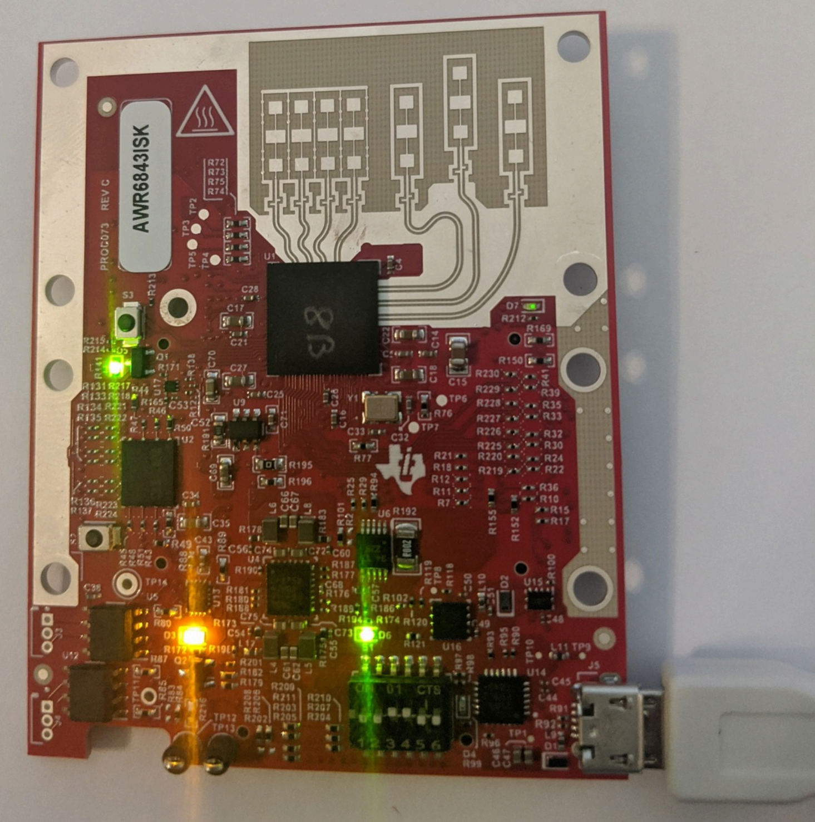
AWR6843ISK Evaluation Kit

Slide 6
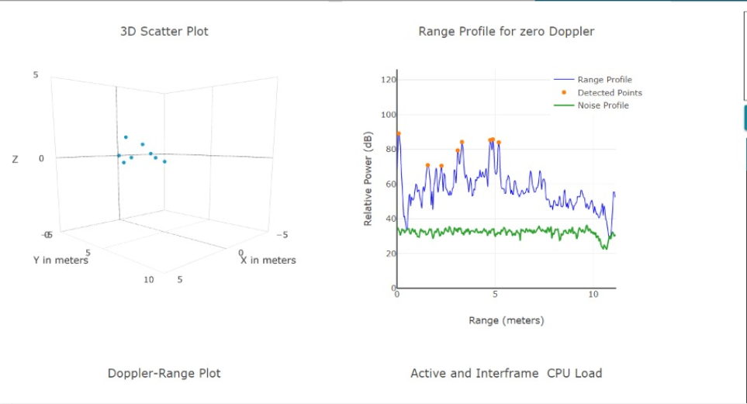
Out-of-the-box demonstration
of mm-Wave Sensor using mm-Wave Visualizer

Slide 7
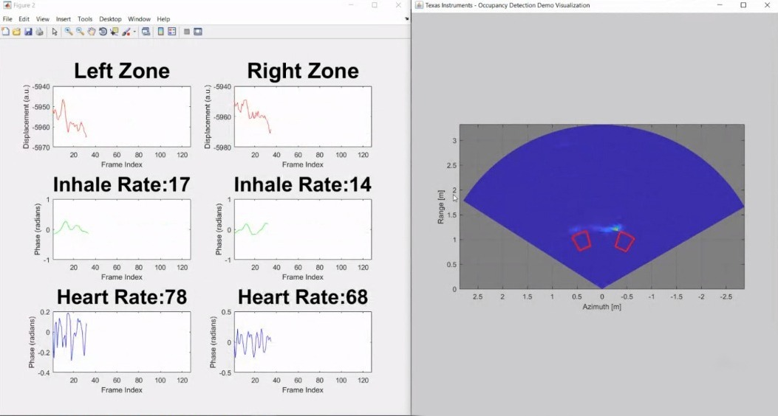
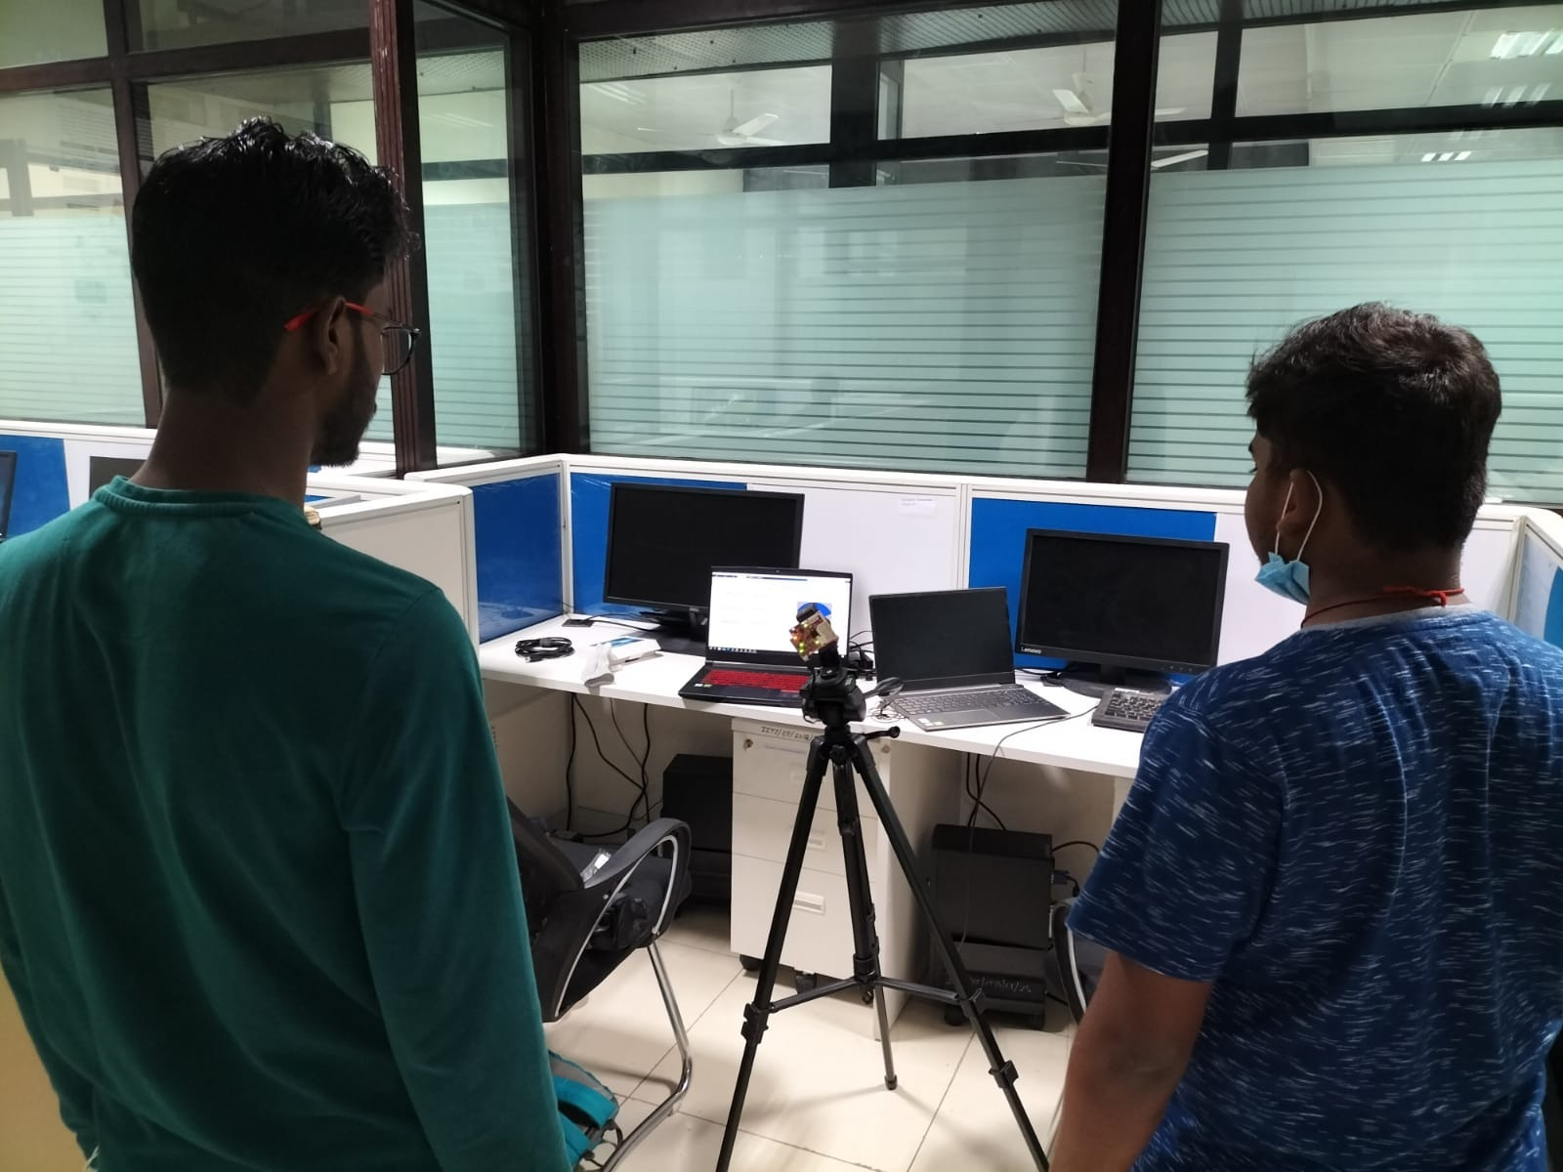
Vital-Signs monitoring and Occupancy detection
Positioning of Occupants

Slide 8
THANK YOU ..!

